Slide 1
Welcome to My Presentation

Slide 2
Name : Meraz Hossen Cesti
Batch : 039
Department : Sociology
Date : 0/12/24

Slide 3

“Good Food, Good Life”.

Slide 4

Overview of Unilever Company

Slide 5
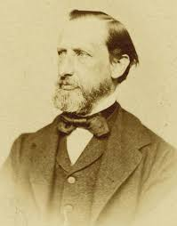

Introduction
Legal Structure & Governance
Nestle was formed in 1867 from
“Nutrition of Infants”.
How Henri Nestlé started the Nestlé we know today
Led by a sense of scientific innovation, Henri Nestlé kickstarted a small food business in 1867. 150 years later that business is the world’s largest food and beverage company. And Henri’s legacy continues to shape the business today.
Henri Nestlé

Slide 6



Our Different Product Segment
Chocolate
Coffee
Baby Food

Slide 7
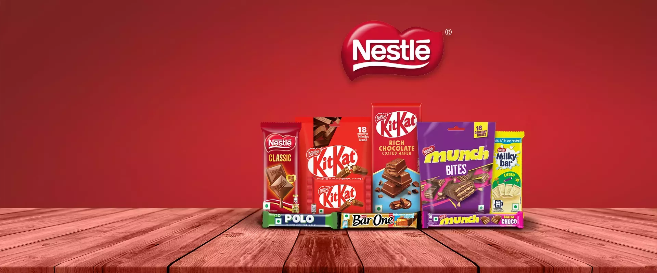
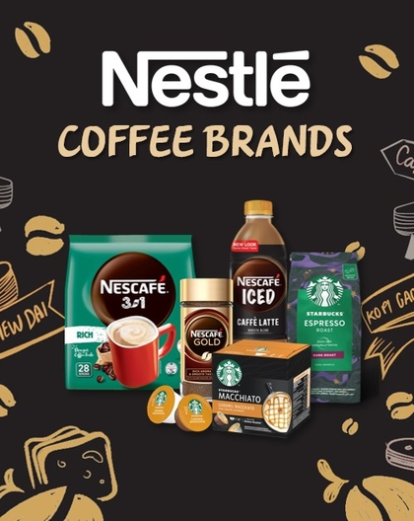
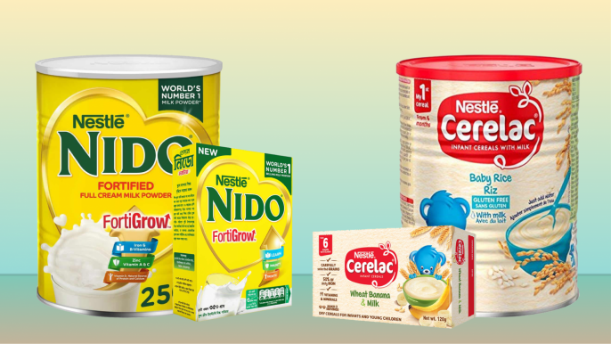
Product and services
Nestle

Slide 8
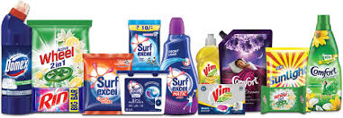
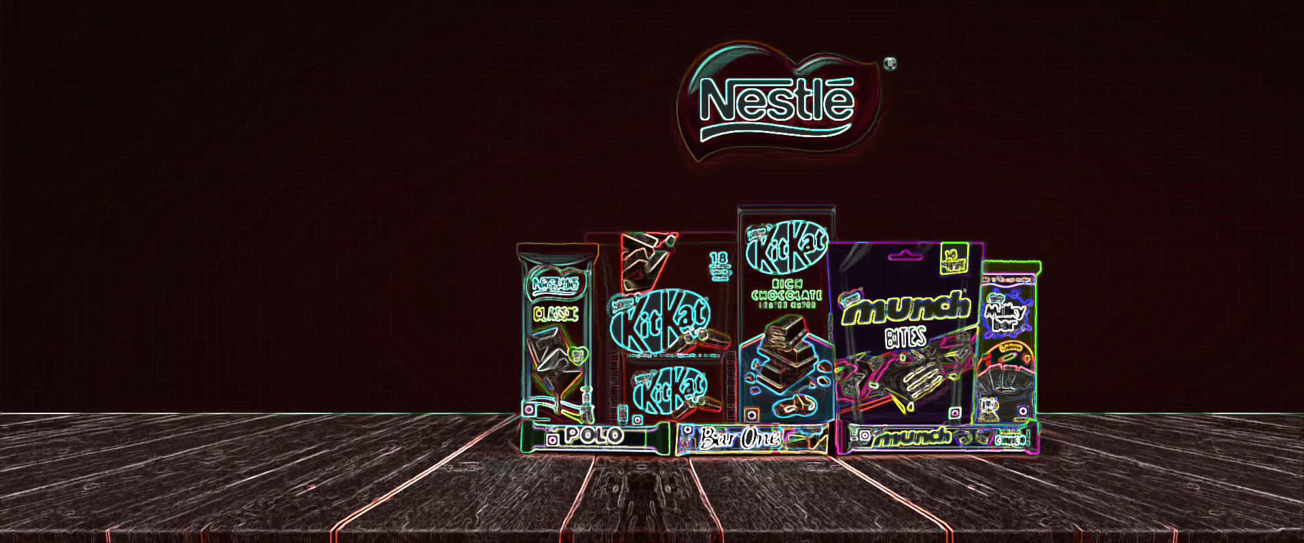
Chocolates
Popular Brands:
Aero, Baci Perugina, KitKat, Milkybar, Smarties
Products:
Chocolates, Bars, Drinks, Shakes.

Slide 9
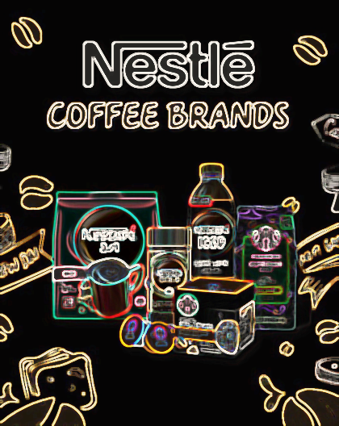
Coffee
Popular Brands:
Nescafe, Starbucks.
Products:
Latte, Iced, Mixed, Drinks, Beans, Crushed, Powder.

Slide 10
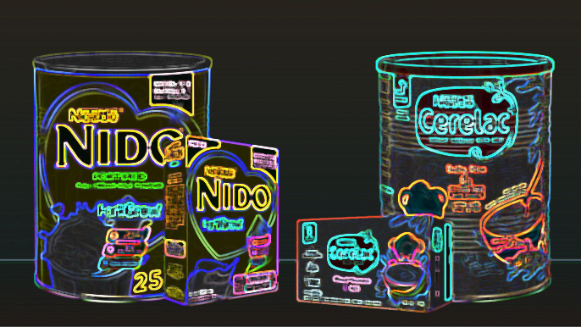
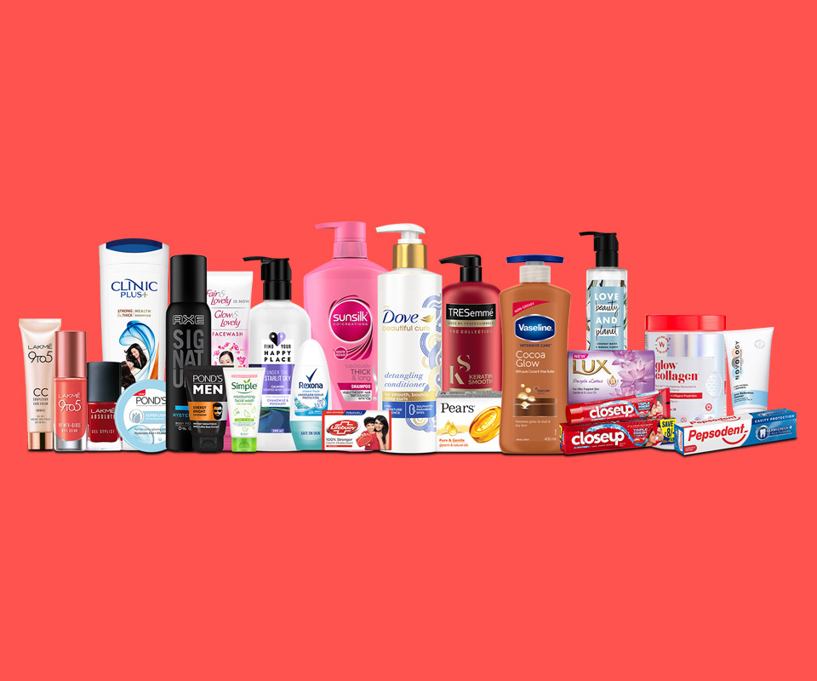
Baby Food
Popular Brands:
Nido, Cerelac.
Products:
Milk, Cereals.

Slide 11
Nestle
Chocolates
Coffee
Baby Food

Slide 12
Nestle Data Analysis
Category | Turnover/ Billion | USG/ %
Chocolate | 6.5 | 7.1
Coffee | 7 | 5.6
Baby food | 6.7 | 3.2
Confectionary | 6.3 | 3.3
Home food | 4.6 | 0.6
Total | 31.1 | 19.8

Slide 14
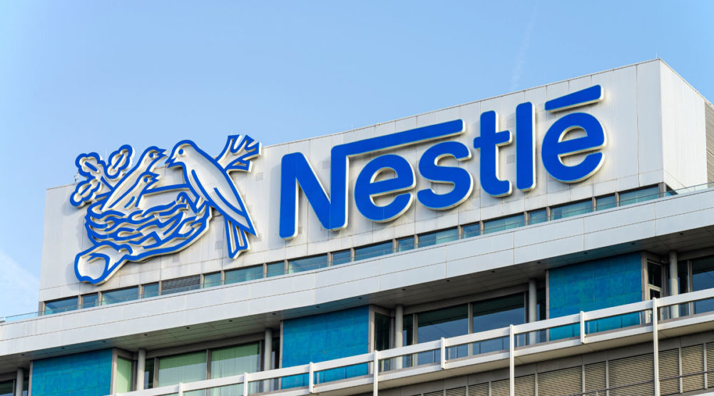
Solid Revenue Growth
Turnover & Growth
In 2023, Nestlé reported CHF 93.0 billion in sales with 7.2% organic growth, driven by price increases and strong performance in Purina PetCare.

Slide 15
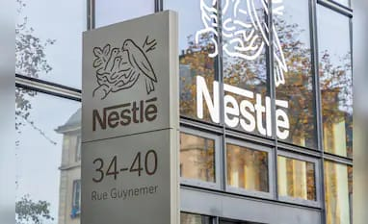
Segmental Insights
Segment & Insight
The Chocolate segment led growth with a turnover of €6.5 billion and a 7.1% USG. Coffee and Nutrition segments reported strong performance, indicating Nestle’s commitment to health and personal hygiene needs. The Baby food segment experienced modest growth, reflecting market challenges.

Slide 16
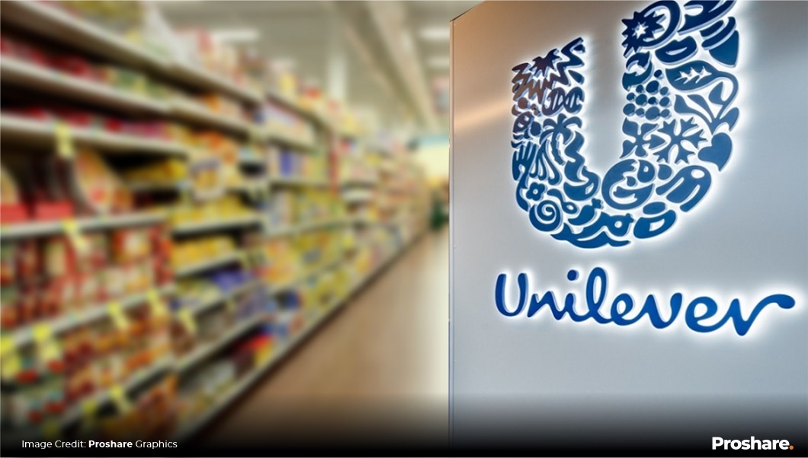
Profitability and Margins
Profit & Margins
In 2023, Nestlé's operating profit margin was 17.1%, supported by pricing strategies and cost management amidst inflationary pressures.

Slide 17
THANKS!

